Slide 1

Digital Marketing Strategy & Content Planning
Subconscious and direct posts.
Learn our T.E.A.M principles.
Understand the value and how to conduct your own Digital Marketing Competitive Audit.
Importance of your Google Listing.
Create a sustainable content plan.
www.SofieAndreou.com
www.SofieAndreou.com

Slide 2

In the area of Digital Marketing What do you think I mean by Sub-conscious vs Conscious
www.SofieAndreou.com

Slide 3
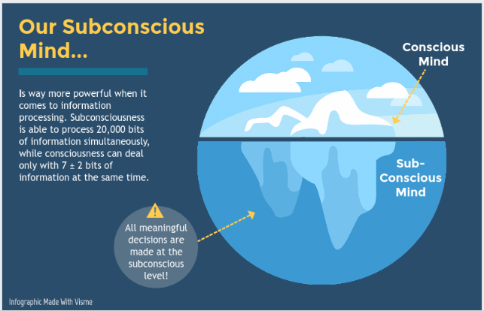
Sub-conscious vs Conscious
www.SofieAndreou.com

Slide 4





Sub-conscious vs Conscious
Marketing
Social Media Vs Google
www.SofieAndreou.com

Slide 5
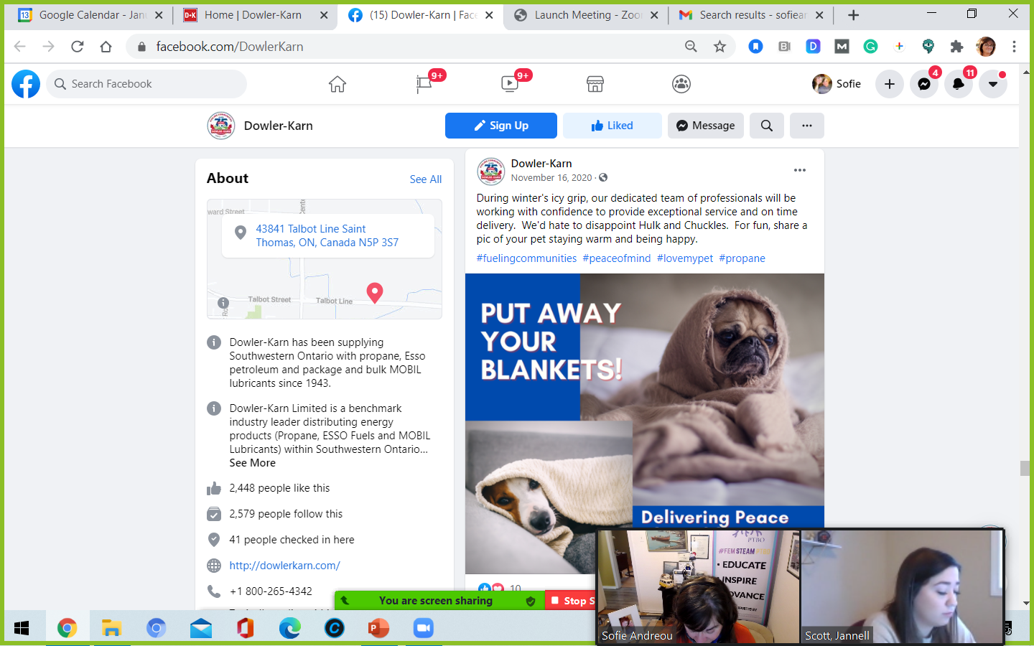
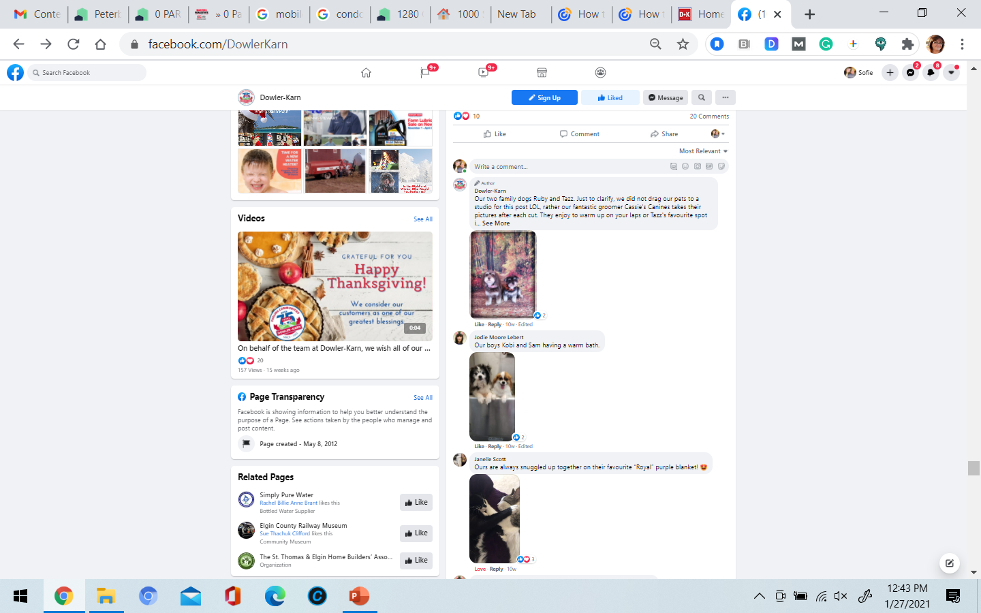
Example: Subconscious Post
www.SofieAndreou.com

Slide 6
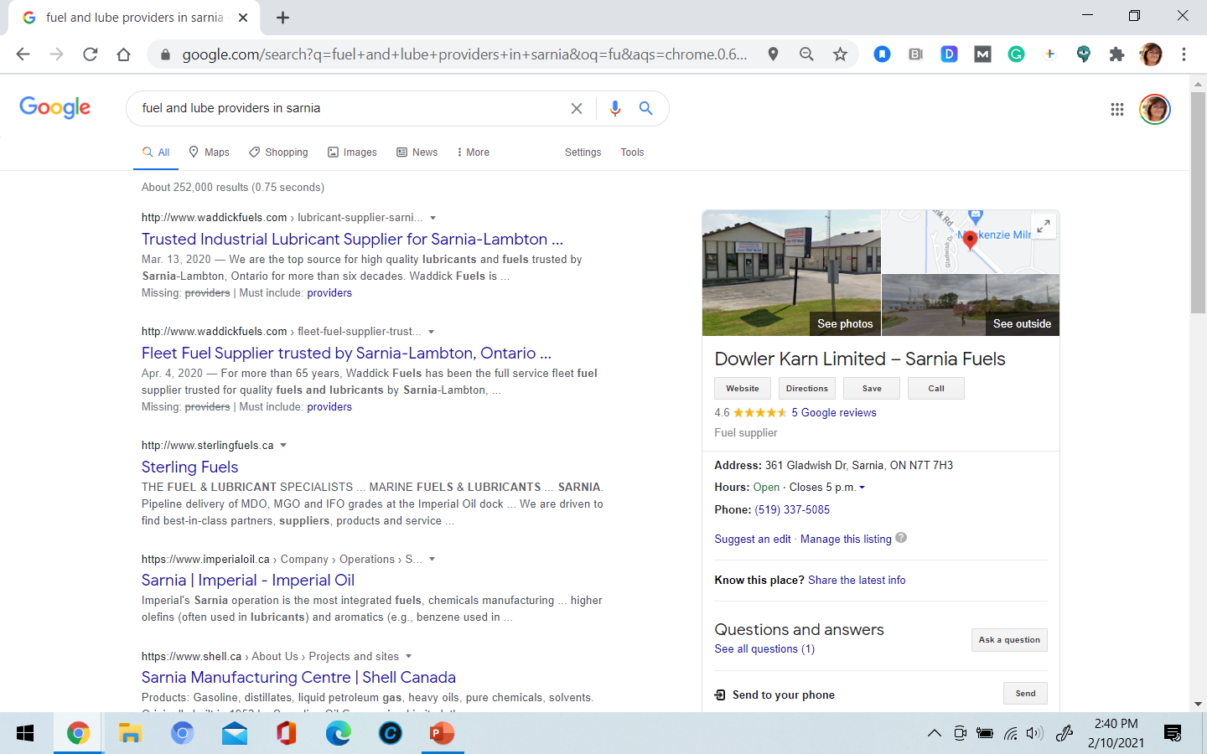
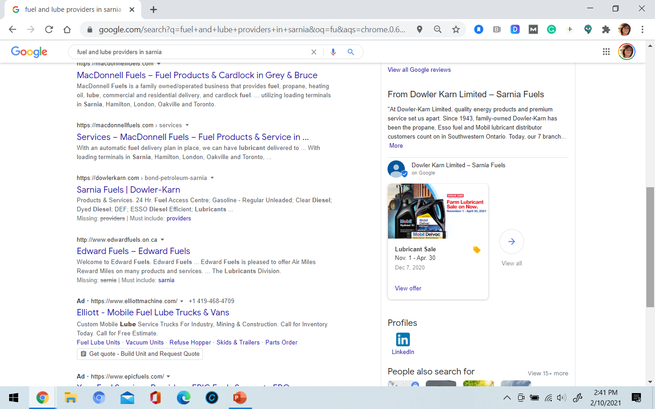
Example: Conscious
www.SofieAndreou.com

Slide 7









81% of consumers’ decisions are influenced by their friends’ social media posts. Sub-conscious! (Source Forbes)
www.SofieAndreou.com

Slide 8
Why Do You Need A Digital Marketing Strategy & Plan!?
www.SofieAndreou.com

Slide 9
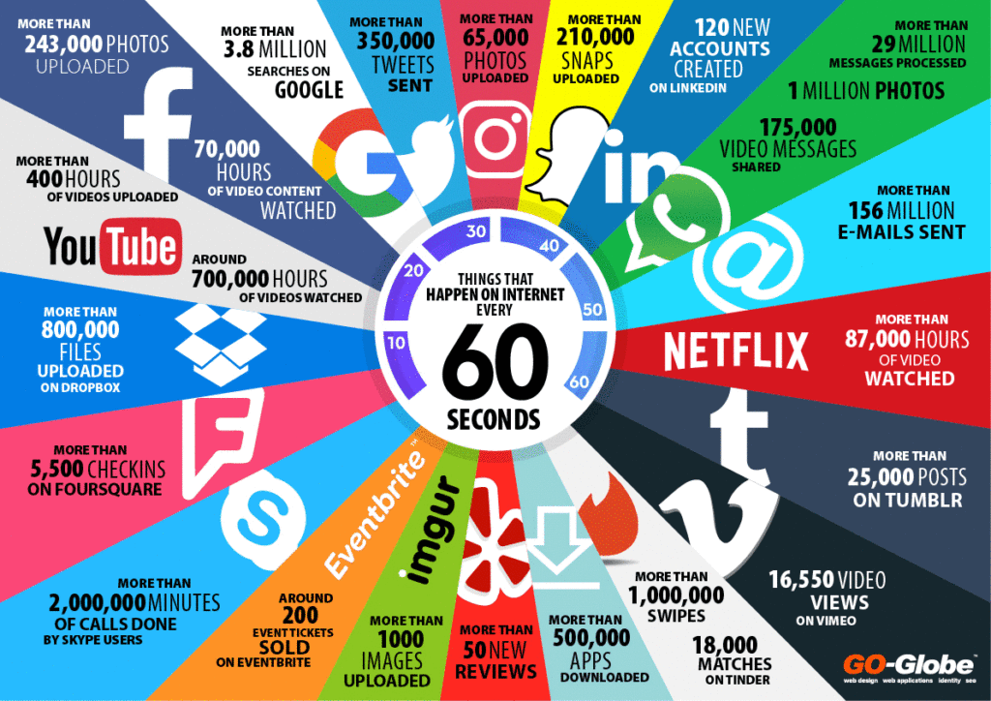
Why Do You Need A Strategy!? – To Be Found & Trusted by Clients!
www.SofieAndreou.com

Slide 10
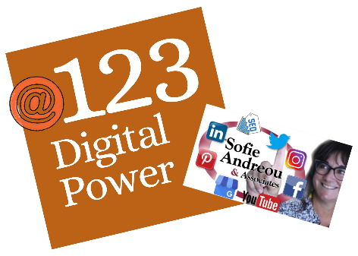
In terms of Digital Marketing,
What do you think
I mean by
T.E.A.M?

Slide 11
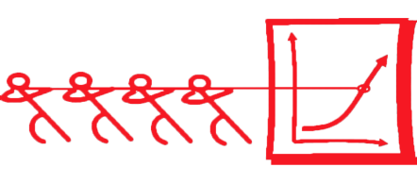
T.E.A.M (Posting Principles)
Trust
Engaging
Actionable
Measurable

Slide 12
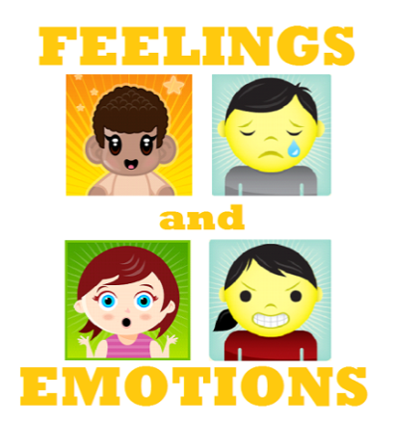

T = TRUST
Authentic

Slide 13
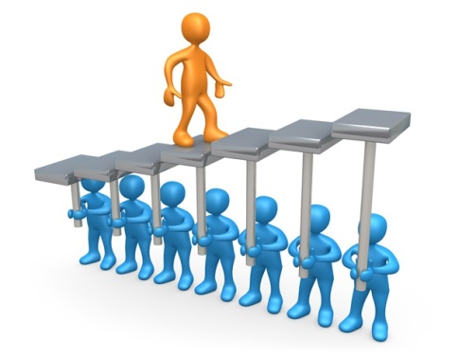
T = TRUST
A Post must instill trust in your brand, product, service or staff. Think creatively on how you do this. One way NOT to do this is by posting "brochure-ware" or stock photos on social media.
One way to instill trust is finding creative ways to entice User Generated content in posts.
I'm referring to either client or staff experiences as User Generated content. To instill trust, the digital solution needs to encourage or capture user experience or staff knowledge. Posting beautifully made brochures and expecting to build trust does not work.
Real life visuals and sentiments from real people instill more trust then brochure-ware.

Slide 14
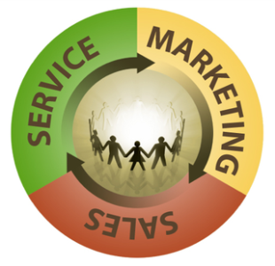


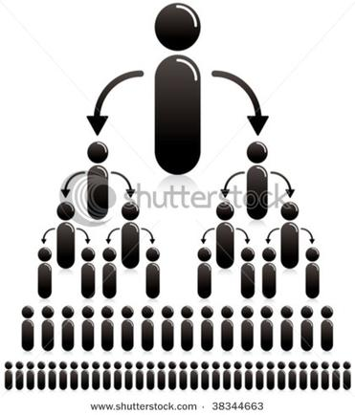
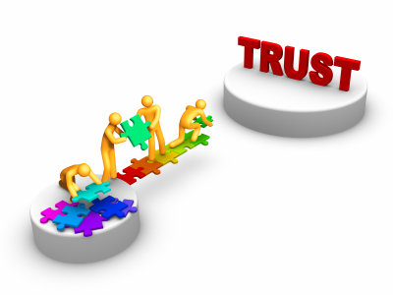
E = Engagement = Growth & Trust

Slide 15
81% of consumers’ purchasing decisions are influenced by their friends’ social media posts. (Source Forbes)

Slide 16




A= Action

Slide 17
Can you think of a
C.T.A
you might add to
your posts!??
www.SofieAndreou.com

Slide 18
Call to Action Examples
Buy NOW! Signing Up For An Event
“Opt-In” ing to your e-Newsletter
Clicking on “more details”
Downloading documents
Linking to your Website from: Directly Social, eNews or Google!
Liking or Following your Social Media Accounts
Viewing an online event’s page.
Viewing Your Map or Call Now
www.SofieAndreou.com

Slide 19
A= Action
Call to action! Why have a call to action in a digital solution? One, we want make it easy for our clients to connect with us and second, you can measure a click (or action). A request to BUY is not appropriate in each post, by rule of thumb, ask for the sale every fifth post, whether implied or direct. However a call to action is not only about asking for the sale, it can also take the form of asking a question, offering value in the way of a DIY videos, coupons, downloadable information, contest instructions, live-stream audiences, Q&As and so much more!
Action creates another level of engagement, trust and a public endorsement. This is how your clients become your sales people.
www.SofieAndreou.com

Slide 20
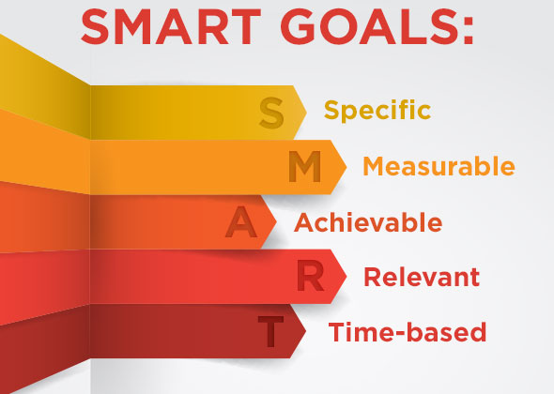
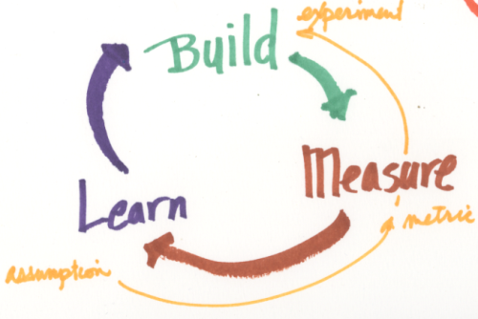
M = Measurable
www.SofieAndreou.com

Slide 21

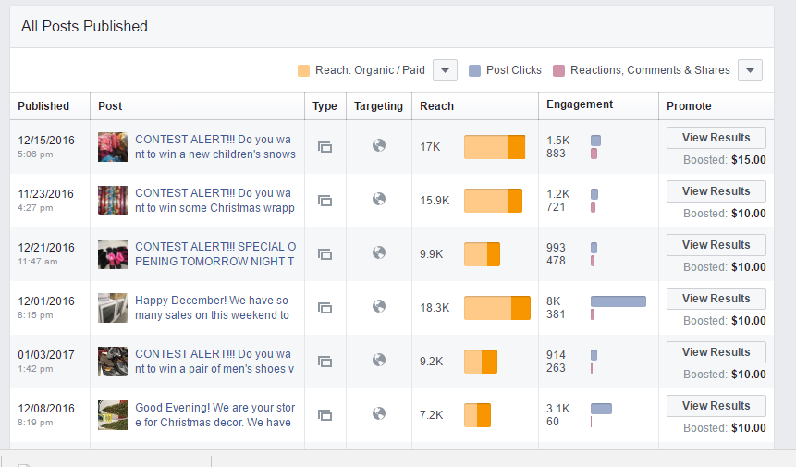
T-E-A-M

Slide 22
M = Measurable
A good digital solution has purpose and solves business goals, therefore must be measurable. Maybe you are rolling out a series of scheduled weekly fun live-streams, featuring staff and client experiences. If your sales are local at one brick & mortar location, you will measure success differently then if your sales are online. So, for a local geographic target, measure success by local viewers and the number of local sales in relation to the number of viewers. If your target is wider or online, you'll measure success by a wider viewer audience, and the number of online sales or website visits to the number of viewers. Your measure of success will be the number of sales or inquires which result following these live-streams. Asking your clients fill in a #Hashtags or coupon code which was only view-able in that same live-stream, to directly track the impact, is just smart digital marketing. An effective marketing solution will utilize a different coupon code in each different marketing medium; print, live-stream, twitter or LinkedIn, to help directly measure the return on that marketing effort's investment.
www.SofieAndreou.com

Slide 23

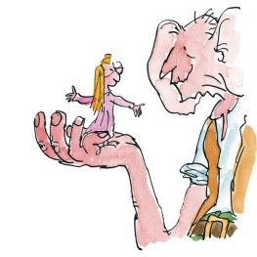

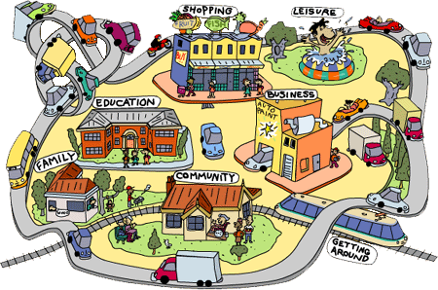

T.E.A.M
www.SofieAndreou.com

Slide 24
T.E.A.M
Once you've determined your company's marketing goals, you are ready to implement T.E.A.M digital marketing plans.
There are many dimensions to TEAM. First, the power of the entire TEAM. The public talking about your brand is stronger then your marketing team yelling about it!
Team is defined in terms of both your external and internal teams. Externally, in your target market, your clients become your company's most powerful sales team. As existing and potential clients engage with your posts, they are actually endorsing your brand and increasing your trust quotient. Your internal staff team must be aware, supportive and continuously improving your digital marketing plans.
www.SofieAndreou.com

Slide 25
In terms of Digital Marketing What is a Competitive Audit?
www.SofieAndreou.com

Slide 26
A Simple Competitive Audit:
Comparing Your Business to 3 Competitors.
www.SofieAndreou.com

Slide 27
A Simple Competitive Audit:
Compare Your Business to 3 Competitors.
Compare your:
Website
Social Media Platforms
Google Listing
www.SofieAndreou.com

Slide 28
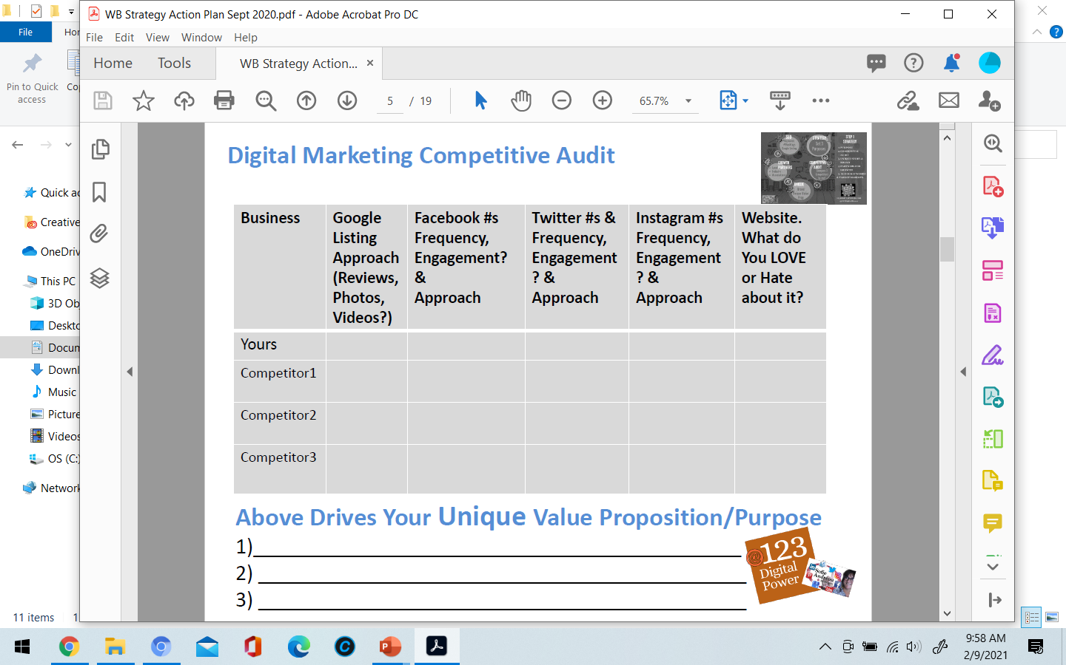
A Simple Competitive Audit:
www.SofieAndreou.com

Slide 29
A Simple Competitive Audit:
www.SofieAndreou.com

Slide 30
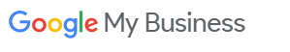

What is a Google Listing!?
www.SofieAndreou.com

Slide 31
What are the elements of a Google Listing!?
www.SofieAndreou.com

Slide 32
What is a Google Listing!?
Photos or Videos
Products
Keywords
Services
Events
Reviews
360 Photos
Contact Info
www.SofieAndreou.com

Slide 33
Do you need to have an Address to have a Google Listing?
www.SofieAndreou.com

Slide 34
Do you need to have an Address to have a Google Listing? NO!!
www.SofieAndreou.com

Slide 35
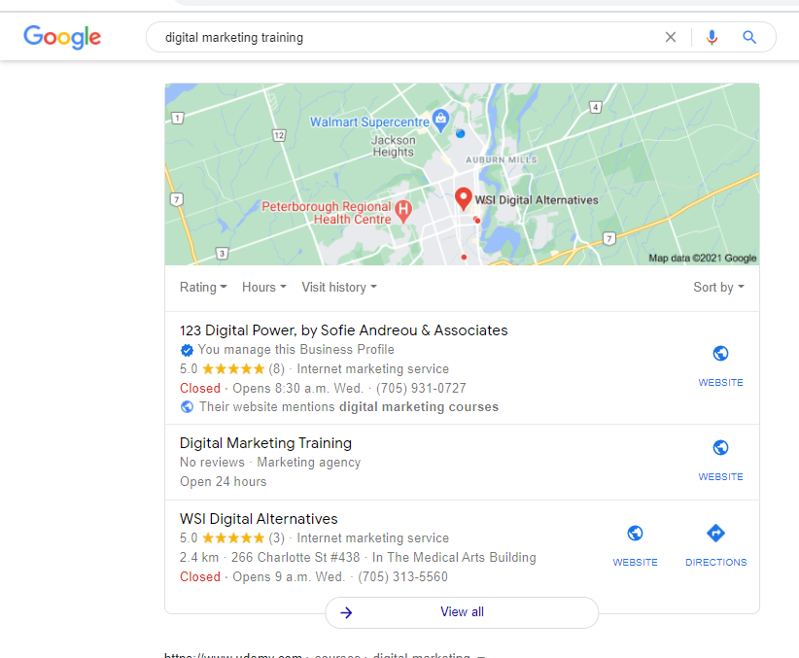
Do you need to have an Address to have a Google Listing? NO!!
www.SofieAndreou.com

Slide 36
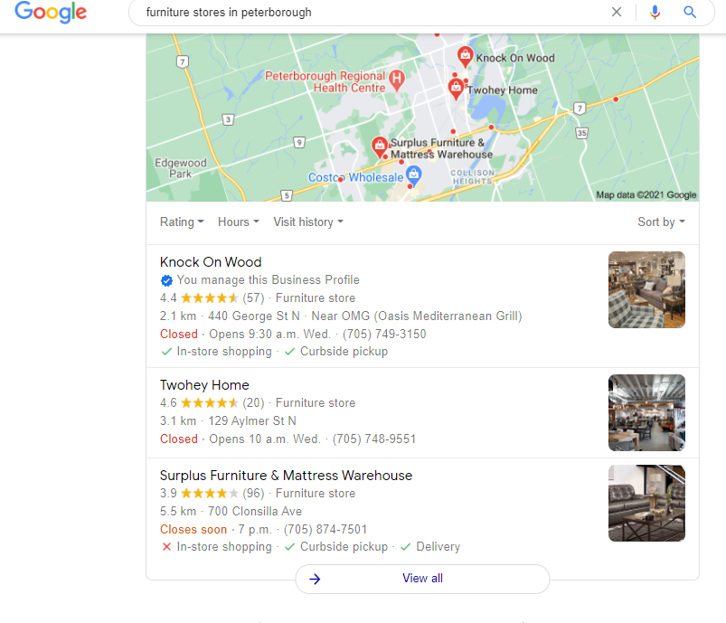
Do you need to have an Address to have a Google Listing? NO!!
www.SofieAndreou.com

Slide 37
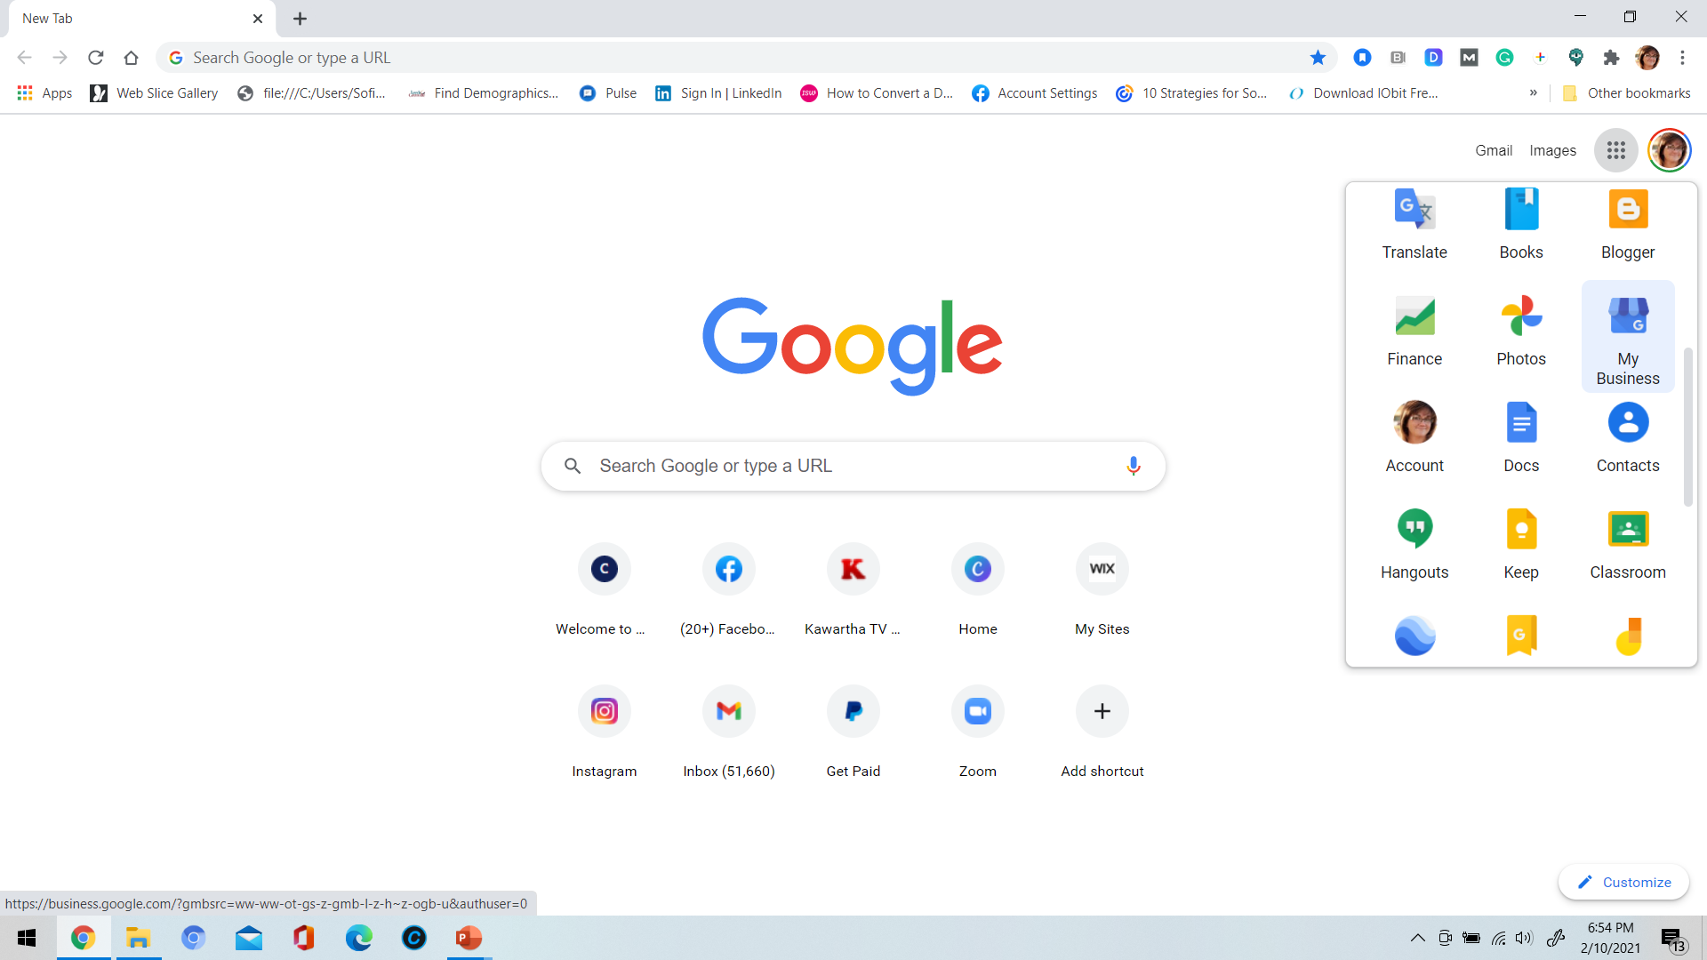
www.SofieAndreou.com

Slide 38
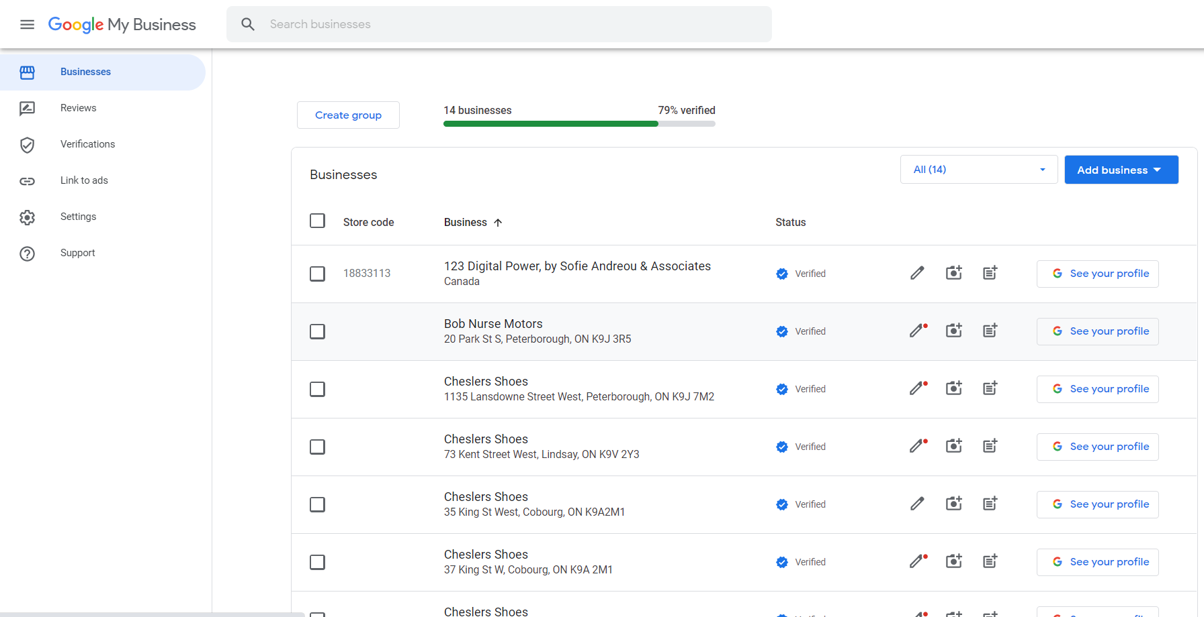
www.SofieAndreou.com

Slide 39
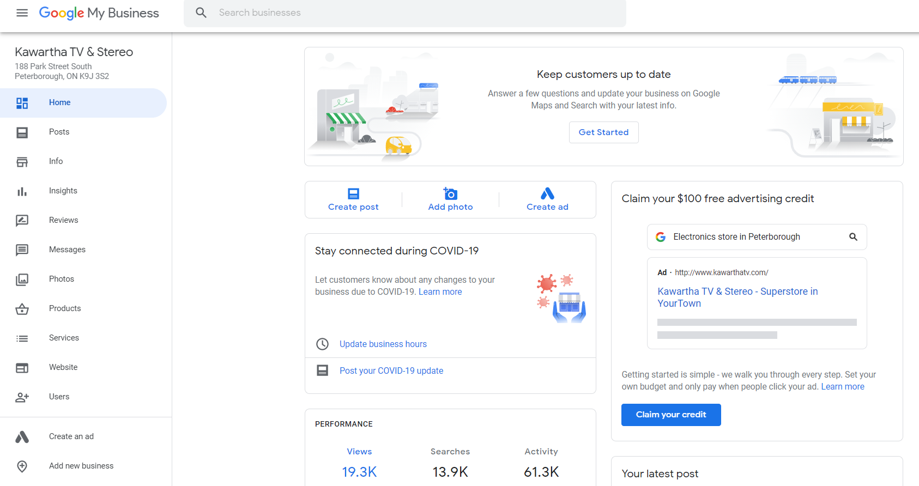
www.SofieAndreou.com

Slide 40
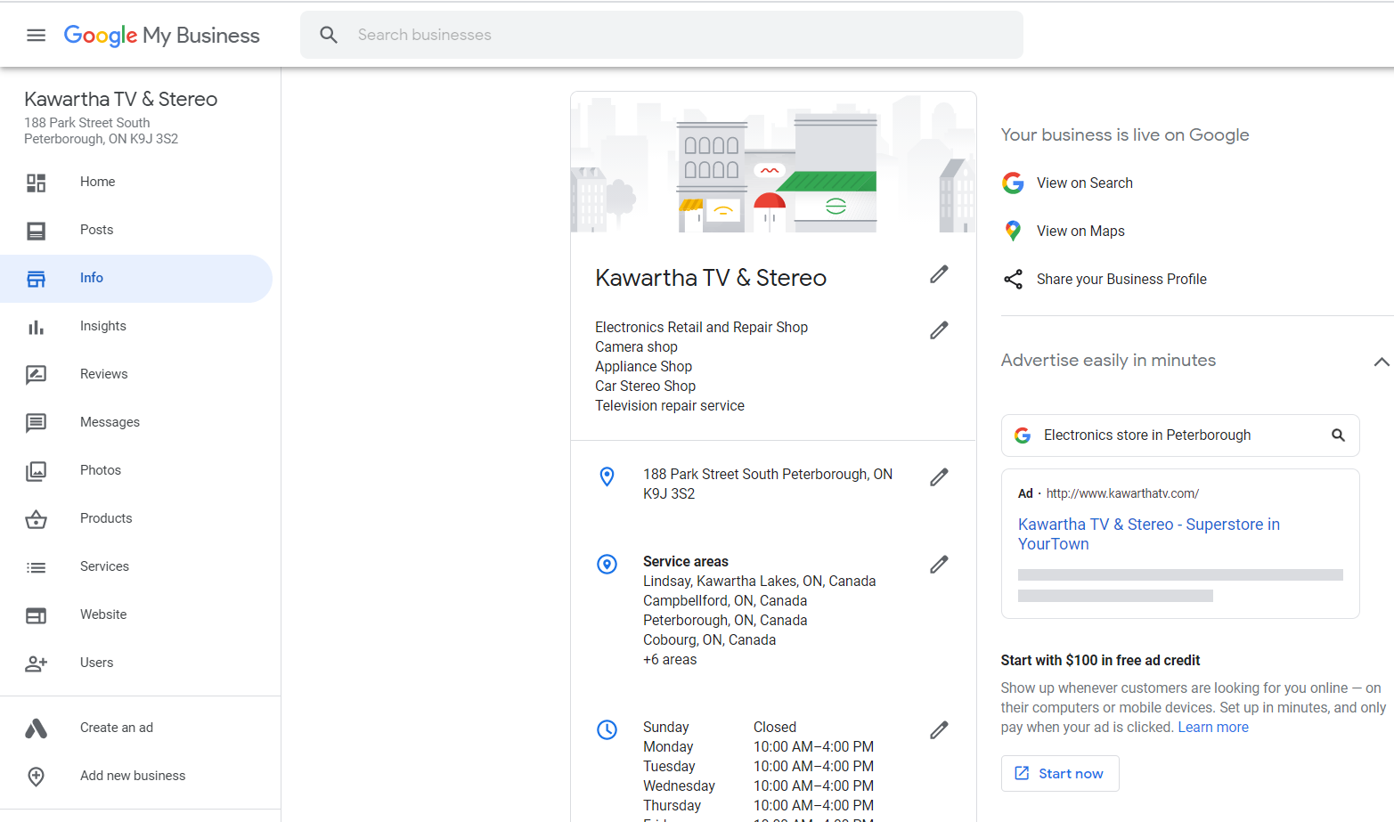
www.SofieAndreou.com

Slide 41
Why Customers Follow You on Social?
www.SofieAndreou.com

Slide 42
Why Customers Follow You on Social?
Educated
Entertained
Inspired
Buy
www.SofieAndreou.com

Slide 43
What are the Steps to thinking about your Social Media Strategy
www.SofieAndreou.com

Slide 44

Steps to a Strategy
Here are the 9 questions you need to answer when creating your community or organizational social strategy.
1. Why do you want online followers? State your purpose.
2. Which keywords or hashtags will lace your posts?
3. Who is your target audience?
4. What social platforms will you use?
5. How will you measure success?
6. List your possible material creators? (Clients, staff, suppliers, industry experts, media)
7. Who will be accountable for measuring and coordinating efforts?
8. List your influencers’ possibilities. Those giants with a large number of social followers who will retweet or share your posts.
9. Create your schedule. How often can your organization post? Twice a day, three times a week?
www.SofieAndreou.com

Slide 45




LinkedIn, Facebook, Twitter, Instagram
?? Demographics
Corporate
Networking
?? mins/month
Posts
Links
Photos
Videos
Groups
Company Pages
Account/Email?
?? Demographics
?? hours/day
Posts
Links
Photos
Videos
Events
Groups
Company Pages
Account/Email?
?? Demographics
Community Based
Happening NOW
Tweets
Links
Photos
Videos
Account/Email?
?? Demographics
Posts
Stories Reels
Highlights
Photo & Video Driven
Links Paid ONLY
IGTV
Account/Email?
www.SofieAndreou.com

Slide 46
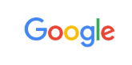

LinkedIn, Facebook, Twitter, Instagram
Story & Highlight
Dimensions
Post Dimensions
Post Dimensions
www.SofieAndreou.com

Slide 47
Social Media Your Purpose??
www.SofieAndreou.com

Slide 48
Social Media Your Purpose
Instill Trust
Industry Knowledge Leadership
Brand Recognition
Networking
Sales
www.SofieAndreou.com

Slide 49
Main Purposes.
Here are the main online marketing purposes we’ve consistently seen across various types of organizations.
To showcase products
To showcase staff
To be position as the expert or “go-to” for specific topics.
To increase traffic to websites or blogs
To increase traffic to your retail store.
To improve communication between your clients, staff, volunteers, or suppliers.
To compliment traditional customer service.
To enable existing clients to share experiences which, in turn, increases drive or donations.
www.SofieAndreou.com

Slide 50
Content Calendar Ideas
www.SofieAndreou.com

Slide 51
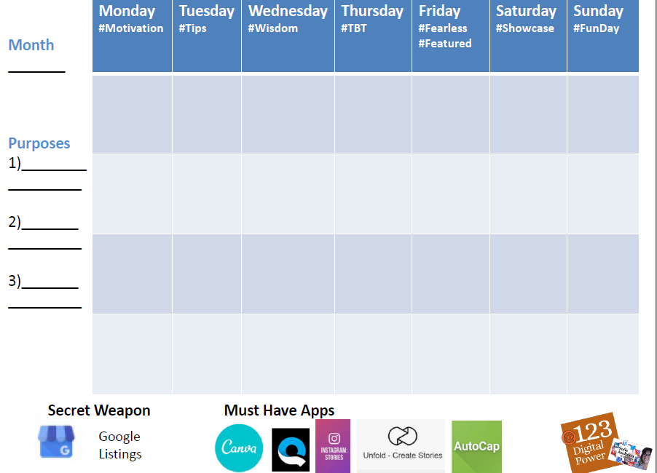

Slide 52
Content Calendar Ideas
FAQs
Meet The Owner
Meet the Team
Showcase Products
Showcase Services
Contests or Promotions
What’s Happening
Community Involvement
Team Sponsorship
Conference Attendance
Debunking Myths
Thought Leadership
Client Case Studies
Testimonials
https://blogs.constantcontact.com/what-to-post-social-media/
www.SofieAndreou.com

Slide 53
Who is your Target Audience.
www.SofieAndreou.com

Slide 54
Target Audience.
There are six traditional ways to identify your target audience.
Where are they located geographically?
How old are they?
What sex are they?
What is their marital status?
Do they have specific interests? Ie Runners, Moms, Sailors
Income level?
www.SofieAndreou.com

Slide 55
Let’s define your Audience:
Determine their pain points and biggest struggles
Figure out what their greatest desires and wants are
Ask yourself what of value can you offer them?
Paint a picture of your target customer/client, or create a buyer persona
https://funneloverload.com/engaging-social-media-content/
www.SofieAndreou.com

Slide 56
Why are Keywords Important?
www.SofieAndreou.com

Slide 57
Keywords are critical
Understand which keywords your customers use in search engines, like Google, when they search for the products or services of your company. Once you have listed your relevant keywords, you can start using them in all of your posts, tweets, online descriptions, categories and other searchable elements, whether on websites, in social networking profiles, blogs or other online presences. Your content needs to be keyword rich.
https://adwords.google.com/select/KeywordToolExternal
www.SofieAndreou.com

Slide 58
What Are Your Keywords
www.SofieAndreou.com

Slide 59
Why Is Livestreaming important??
www.SofieAndreou.com

Slide 60
Why Is Livestreaming important??
Greater Trust
Greater Reach
MORE SALES
www.SofieAndreou.com

Slide 61
TIPs Live On Social Media
Lunch & Learns
Virtual Product Demos
Take people behind-the-scenes
Meet You or your team
Promotions, etc.
www.SofieAndreou.com

Slide 62
TIP User Generated Content
In 85% of cases, consumers are more likely to trust user-generated content!
www.SofieAndreou.com

Slide 63
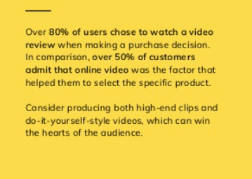
TIP Video Content Becomes Even More Popular
www.SofieAndreou.com

Slide 64
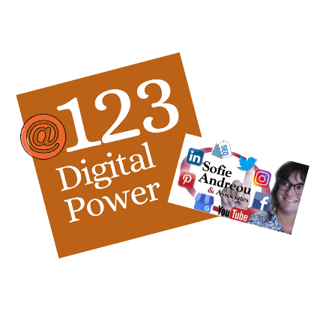
TIP More Interactive Content
Video/Data Visualization
Infographic
Polls
www.SofieAndreou.com

Slide 65
TIP
Social content for good.
www.SofieAndreou.com

Slide 66
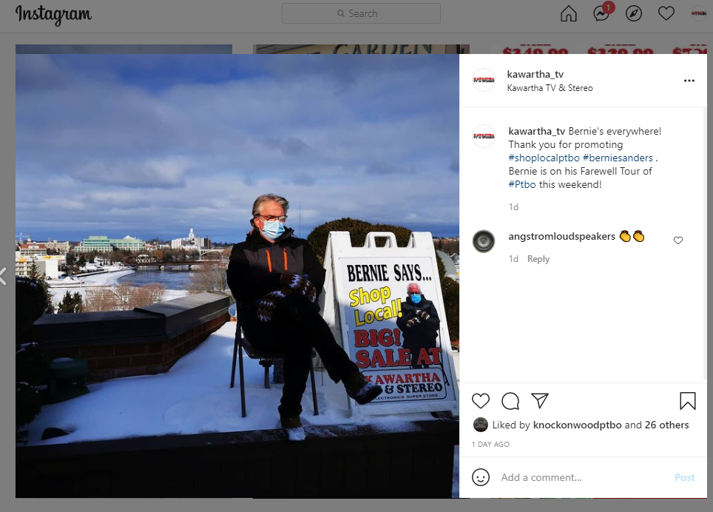
Now let's … - Educate - Entertain - Inspire - Sell (Timely & Funny!)
www.SofieAndreou.com

Slide 67
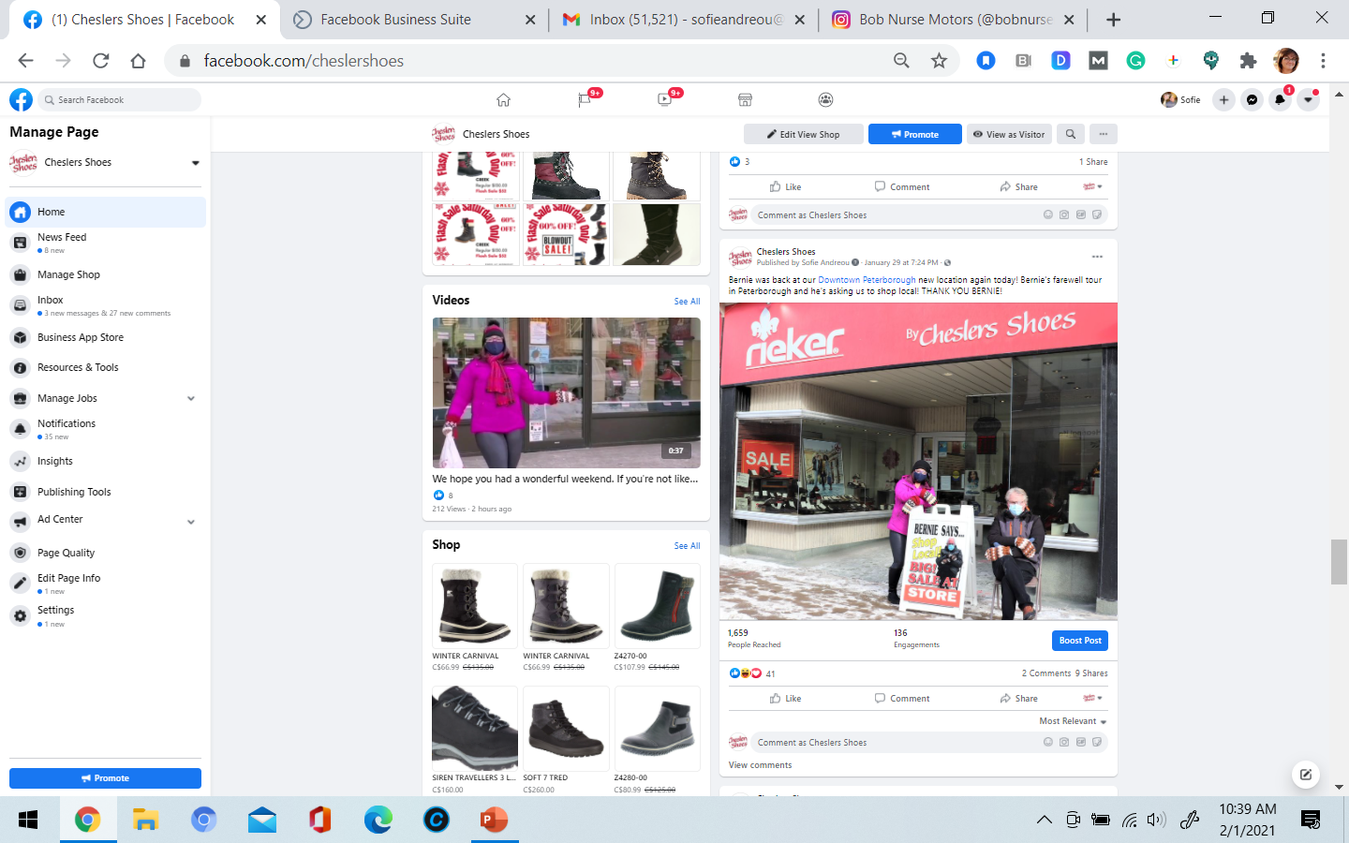
Now let's … - Educate - Entertain - Inspire - Sell (Work Together, Timely & Funny!)
www.SofieAndreou.com

Slide 68
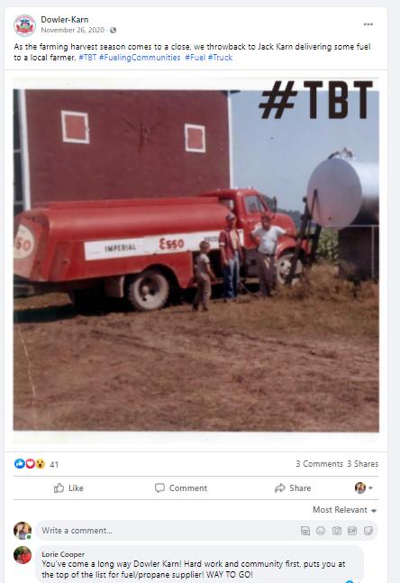
Now let's … - Educate - Entertain - Inspire - Sell (Shows company’s Legacy!)
FAQs – Knowledge Leadership
Meet the Team – Trust & KL
Products – Sales
Promotions - Sales
Contests – Brand Recognition
What’s Happening
Community Involvement -Trust & Brand Recognition
Team Sponsorship – Trust & Brand Recognition
Conference Attendance – Networking & Brand Recognition
Debunking Myths – Trust & KL
Thought Leadership – Trust & KL & Sales
Client Case Studies – Trust & KL & Sales
Testimonials – Trust & KL & Sales
Who Are WE? – Trust & KL
www.SofieAndreou.com

Slide 69
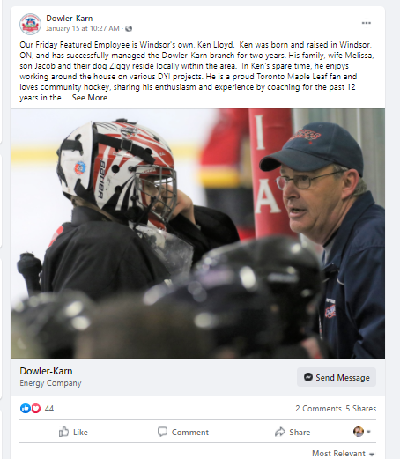
FAQs – Knowledge Leadership
Meet the Team – Trust & KL
Products – Sales
Promotions - Sales
Contests – Brand Recognition
What’s Happening
Community Involvement -Trust & Brand Recognition
Team Sponsorship – Trust & Brand Recognition
Conference Attendance – Networking & Brand Recognition
Debunking Myths – Trust & KL
Thought Leadership – Trust & KL & Sales
Client Case Studies – Trust & KL & Sales
Testimonials – Trust & KL & Sales
Who Are WE? – Trust & KL
Now let's … - Educate - Entertain - Inspire - Sell (Shows Employees)
www.SofieAndreou.com

Slide 70
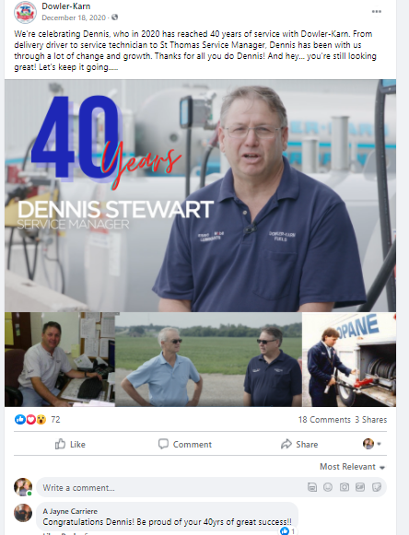
FAQs – Knowledge Leadership
Meet the Team – Trust & KL
Products – Sales
Promotions - Sales
Contests – Brand Recognition
What’s Happening
Community Involvement -Trust & Brand Recognition
Team Sponsorship – Trust & Brand Recognition
Conference Attendance – Networking & Brand Recognition
Debunking Myths – Trust & KL
Thought Leadership – Trust & KL & Sales
Client Case Studies – Trust & KL & Sales
Testimonials – Trust & KL & Sales
Who Are WE? – Trust & KL
Now let's … - Educate - Entertain - Inspire - Sell (Shows Employees!)
www.SofieAndreou.com

Slide 71
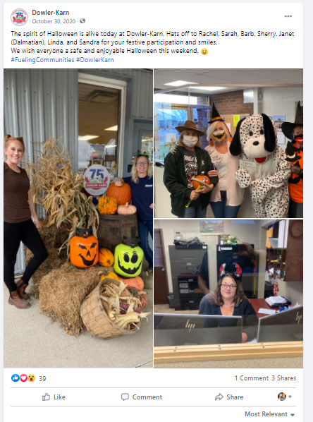
Now let's … - Educate -Entertain - Inspire - Sell (Behind the scenes)
FAQs – Knowledge Leadership
Meet the Team – Trust & KL
Products – Sales
Promotions - Sales
Contests – Brand Recognition
What’s Happening
Community Involvement -Trust & Brand Recognition
Team Sponsorship – Trust & Brand Recognition
Conference Attendance – Networking & Brand Recognition
Debunking Myths – Trust & KL
Thought Leadership – Trust & KL & Sales
Client Case Studies – Trust & KL & Sales
Testimonials – Trust & KL & Sales
Who Are WE? – Trust & KL
www.SofieAndreou.com

Slide 72
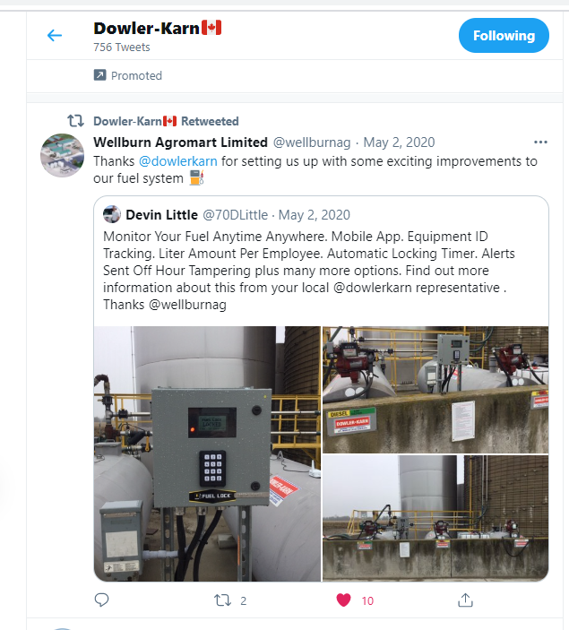
Now let's … - Educate -Entertain - Inspire - Sell (Client Successes)
www.SofieAndreou.com

Slide 73
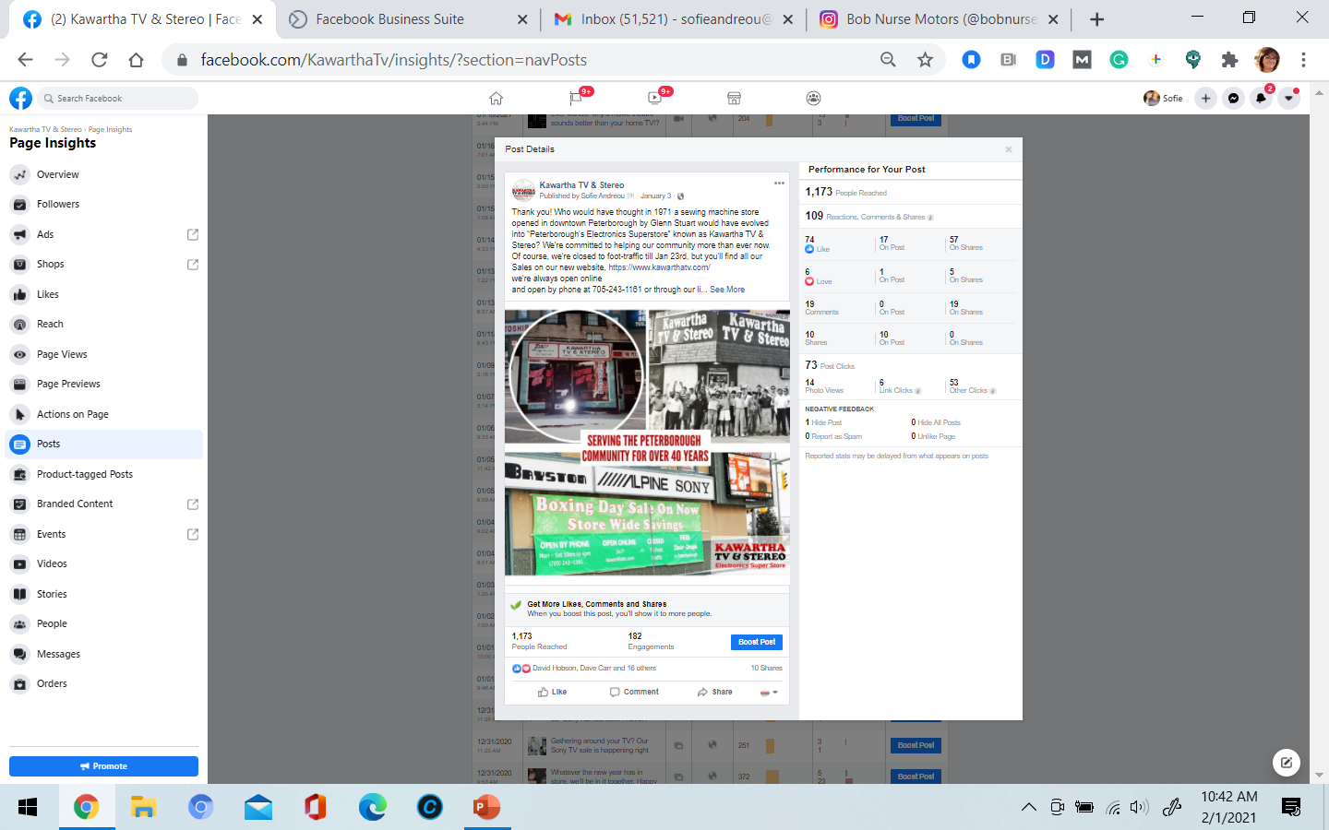
Now let's … - Educate -Entertain - Inspire - Sell (Tell Your Story)
www.SofieAndreou.com

Slide 74
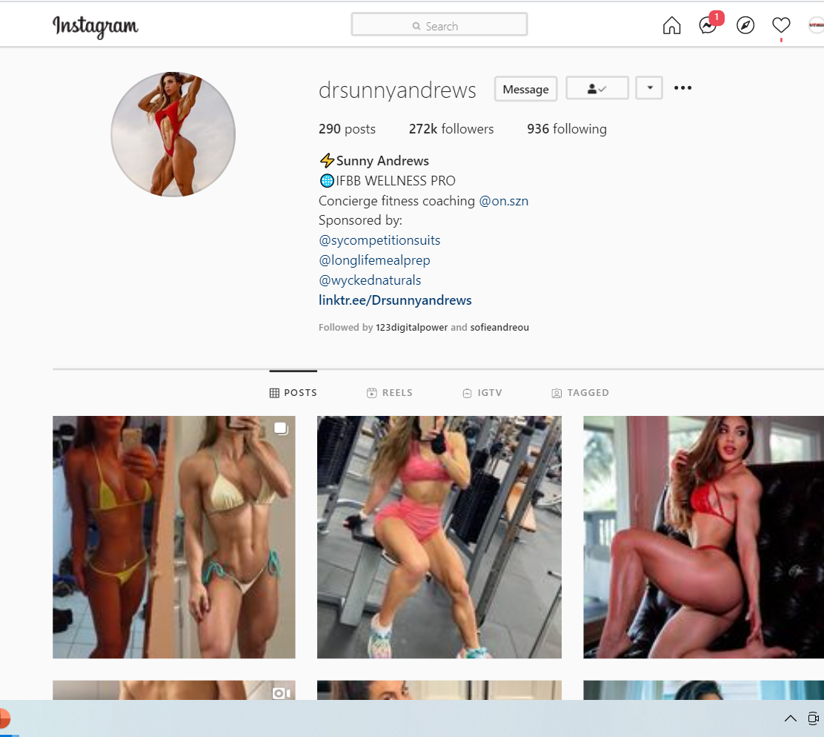
Now let's … - Educate -Entertain - Inspire - Sell (Tell Your Story)
www.SofieAndreou.com

Slide 75
Elements of a Good Post
Think of your Purposes this post is driven by?
How you’ll make it Inspiring, Educational, or Entertaining?
Image or Video
that Inspires or Entertains
Keywords?
Influencers to Tag?
Call to Action?
Which Platforms?
www.SofieAndreou.com

Slide 76
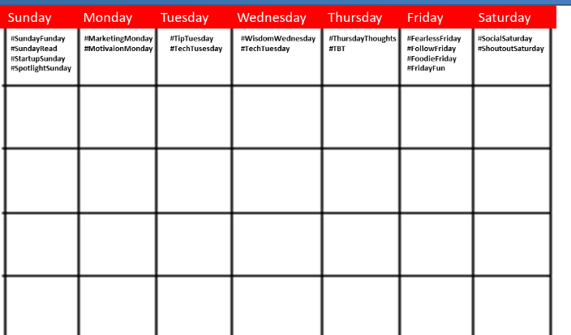
Monthly Planning
Monthly Planning Day.
Choose which upcoming events and themes to “cover”
Pick an ambassador to send or take the photos or videos required for each Event and Theme
List the CTA, if applicable, for each event or theme.
List growth ambassador you might tag for each event or theme.
Identify your Social Media Budget
www.SofieAndreou.com

Slide 77
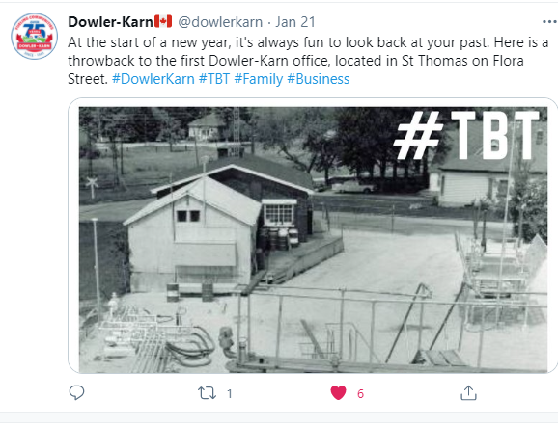
Planning #TBT
www.SofieAndreou.com

Slide 78
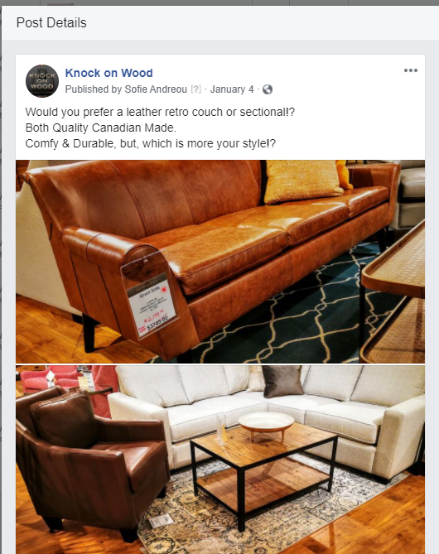
Planning #Wisdomwednesday or TBT
Planning Ask For Input!!
www.SofieAndreou.com

Slide 79
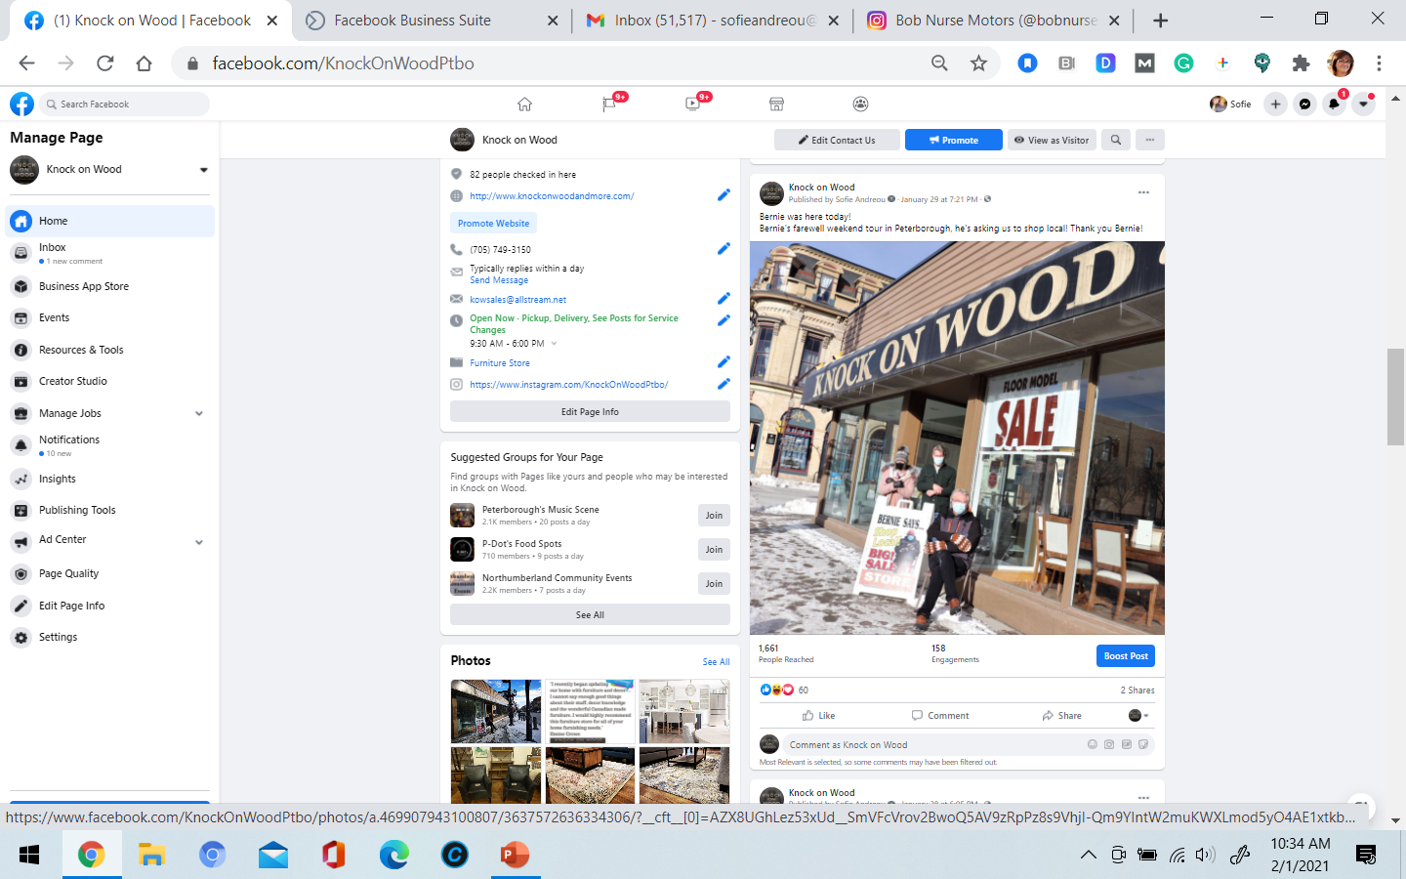
Planning #Wisdomwednesday or TBT
Planning Timely & Funny
www.SofieAndreou.com

Slide 80
www.SofieAndreou.com

Slide 81
Content Marketing Tips
1. Write about what people want to learn about.
2. Build a contributor network.
3. You don’t have to produce all original content.
4. Create a content calendar.
5. Amplify your content.
6. Extend to other publications.
https://www.timeanddate.com/holidays/canada/
https://medium.com/better-marketing/content-marketing-mastering-the-basics-2f31e78523ef
www.SofieAndreou.com

Slide 82
Plan your known marketing campaigns
The first thing I recommend doing is printing the calendar and go through each month, choose your hashtags and add in any dates that might be important to your organization specifically. Maybe you want to make note of your organization’s annual gala, or your business’s annual community event.
https://blogs.constantcontact.com/online-marketing-calendar/#download-calendar-template
www.SofieAndreou.com

Slide 83
Acknowledge appropriate holidays or online events!
January 2021
January 1 – New Year’s Day
January 10 – Houseplant Appreciation Day
January 14 – National Dress Up Your Pet Day
January 18 – Martin Luther King Jr Day
January 24 – National Compliment Day
January 28 – Bell Let’s Talk Day
January 29 – National Puzzle Day
Monthly themes
New year, a fresh start
Building healthy habits
National Mentoring Month
https://blogs.constantcontact.com/online-marketing-calendar/#download-calendar-template
www.SofieAndreou.com

Slide 84
June’s Hashtags & Themes https://blogs.constantcontact.com/online-marketing-calendar/#download-calendar-template
June 2021
June 6 — Drive-In Movie Day
June 8 — Best Friends Day
June 14 — Flag Day
June 19 — Juneteenth Independence Day
June 20 — June Solstice / First Day of Summer
June 20 — Father’s Day
Monthly themes
LGBTQ+ Pride Month
www.SofieAndreou.com

Slide 85
Acknowledge appropriate holidays or online events!
July 2021
July 1 — International Joke Day
July 4 — Independence Day
July 17 — World Emoji Day
July 19 — Ice Cream Day
July 22 — National Hot Dog Day
Monthly themes
National Ice Cream Month
https://blogs.constantcontact.com/online-marketing-calendar/#download-calendar-template
www.SofieAndreou.com

Slide 86
June 2021 Hashtags
June 2021 hashtag calendar:
June 4 – National Donut Day #NationalDonutDay.
June 5 – World Environment Day #WorldEnvironmentDay.
June 6 – Higher Education Day #HigherEducationDay.
June 6 – National Cancer Survivor's Day #NCSD2021.
June 8 – World Oceans Day #WorldOceansDay.
June 8 – Best Friends Day #BestFriendsDay.
www.SofieAndreou.com

Slide 87
july 2021 Hashtags
July 1 – National Postal Worker Day #NationalPostalWorkerDay.
July 2 – World UFO Day #WorldUFODay.
July 4 – Independence Day #July4th.
July 7 – World Chocolate Day #WorldChocolateDay.
July 11 – Cheer Up the Lonely Day #CheerUpTheLonelyDay.
July 12 – Malala Day #MalalaDay.
www.SofieAndreou.com

Slide 88
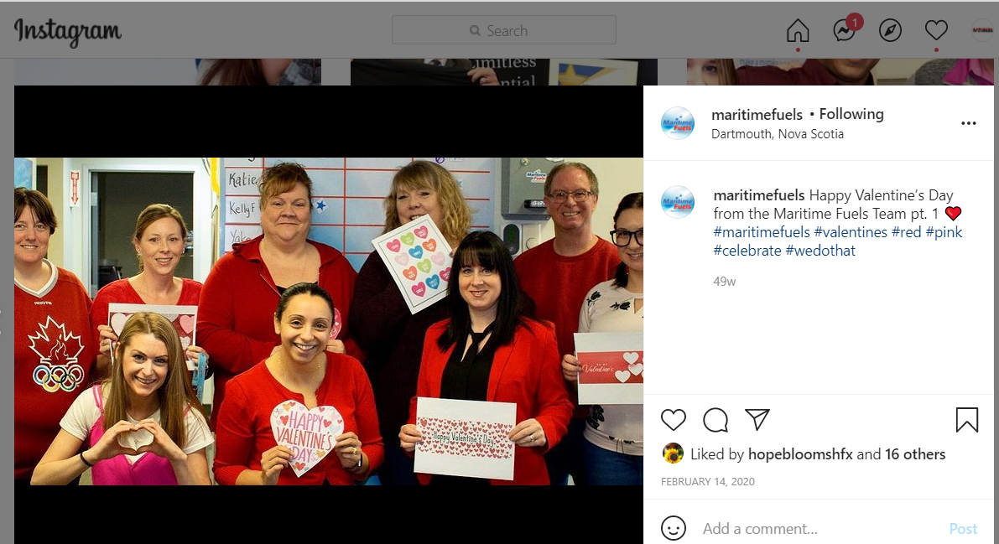
Planning #Valentines
www.SofieAndreou.com

Slide 89
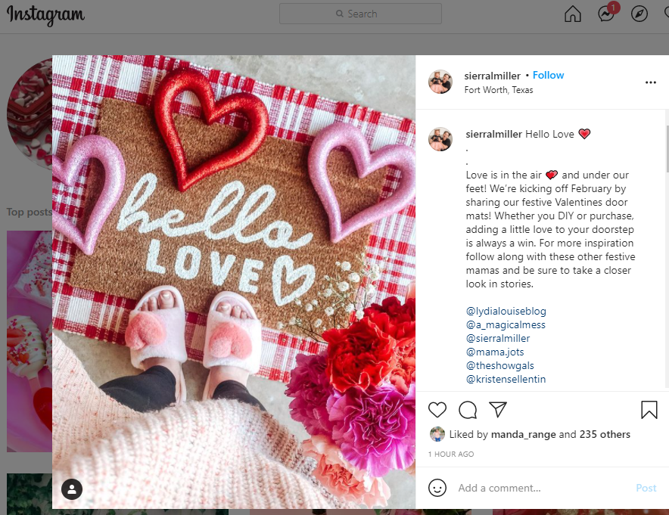
Planning #Valentines
www.SofieAndreou.com

Slide 90
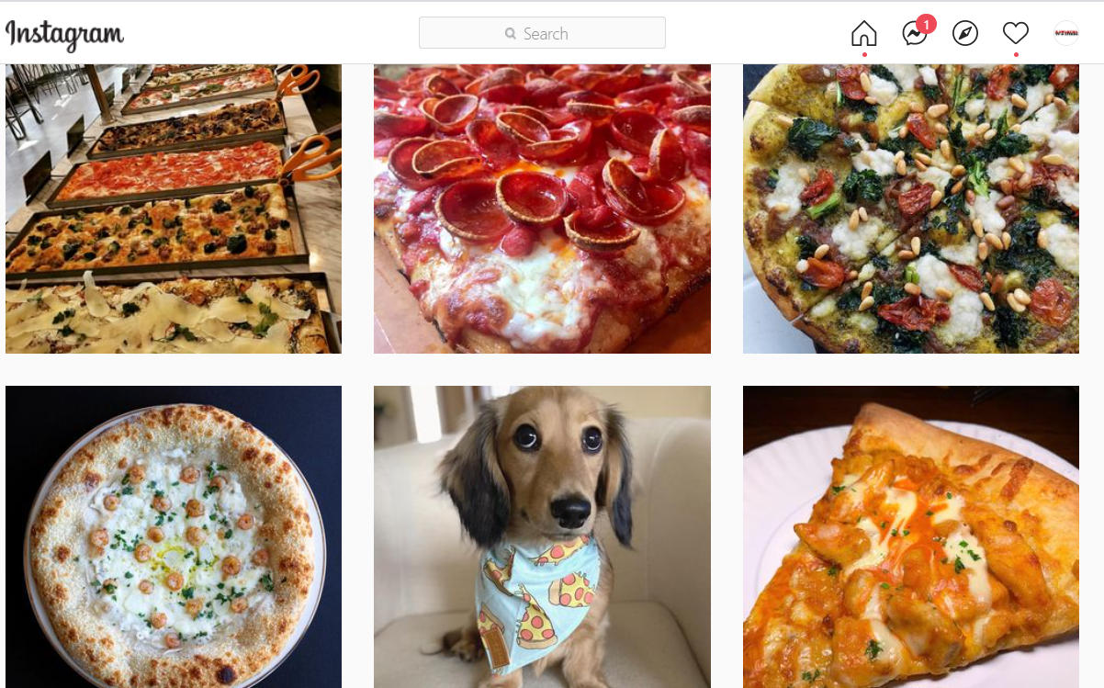
Planning #Nationalpizzaday
www.SofieAndreou.com

Slide 91
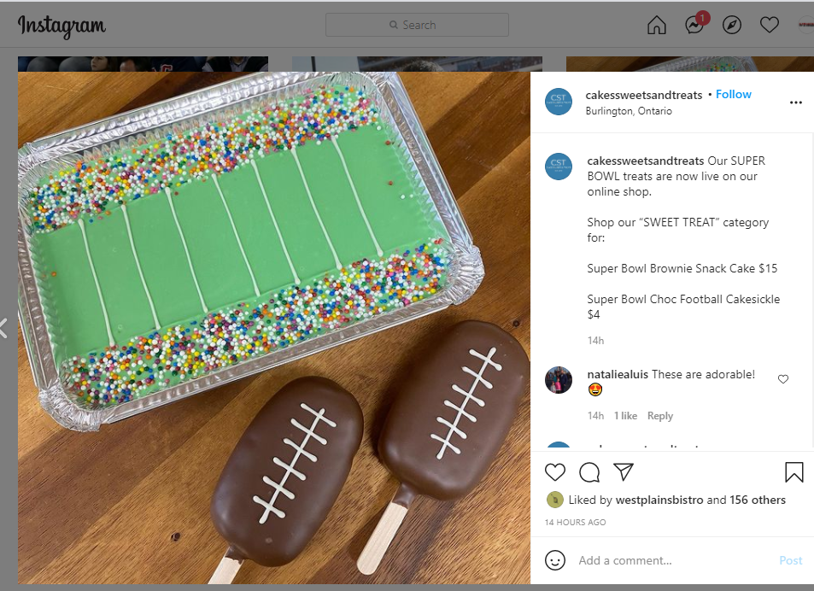
Planning #Nationalpizzaday
www.SofieAndreou.com

Slide 92
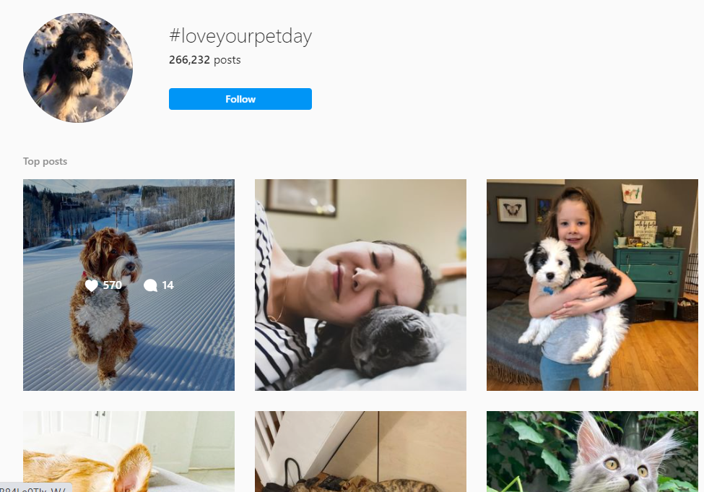
Planning #LoveYourpetday
www.SofieAndreou.com

Slide 93

Apps DEsk top
Unfold
Quik
Canva
Animoto

Slide 94
Resources
https://dabrianmarketing.com/blog/marketing-strategy/8-key-digital-marketing-trends-2021/#:~:text=Social%20Media%20To%20Engage%20%26%20Retain&text=During%20the%20COVID%2D19%20pandemic,products%2C%20brands%2C%20and%20organizations
https://www2.slideshare.net/DianaVicente6/web-design-trends-for-2021?qid=e1354dc0-7ebf-4fa0-8387-c0ddee325d85&v=&b=&from_search=4
https://www.smartinsights.com/digital-marketing-strategy/social-media-trends-2021
https://www2.slideshare.net/DarleneFlorrie/8-main-content-marketing-trends-of-2021?qid=e1354dc0-7ebf-4fa0-8387-c0ddee325d85&v=&b=&from_search=7
https://www2.slideshare.net/DarleneFlorrie/8-main-content-marketing-trends-of-2021?qid=e1354dc0-7ebf-4fa0-8387-c0ddee325d85&v=&b=&from_search=7
https://www2.slideshare.net/DarleneFlorrie/8-main-content-marketing-trends-of-2021?qid=e1354dc0-7ebf-4fa0-8387-c0ddee325d85&v=&b=&from_search=7
www.SofieAndreou.com

Slide 95

Thank you!
SofieAndreou@gmail.com
www.SofieAndreou.com

